Slide 1



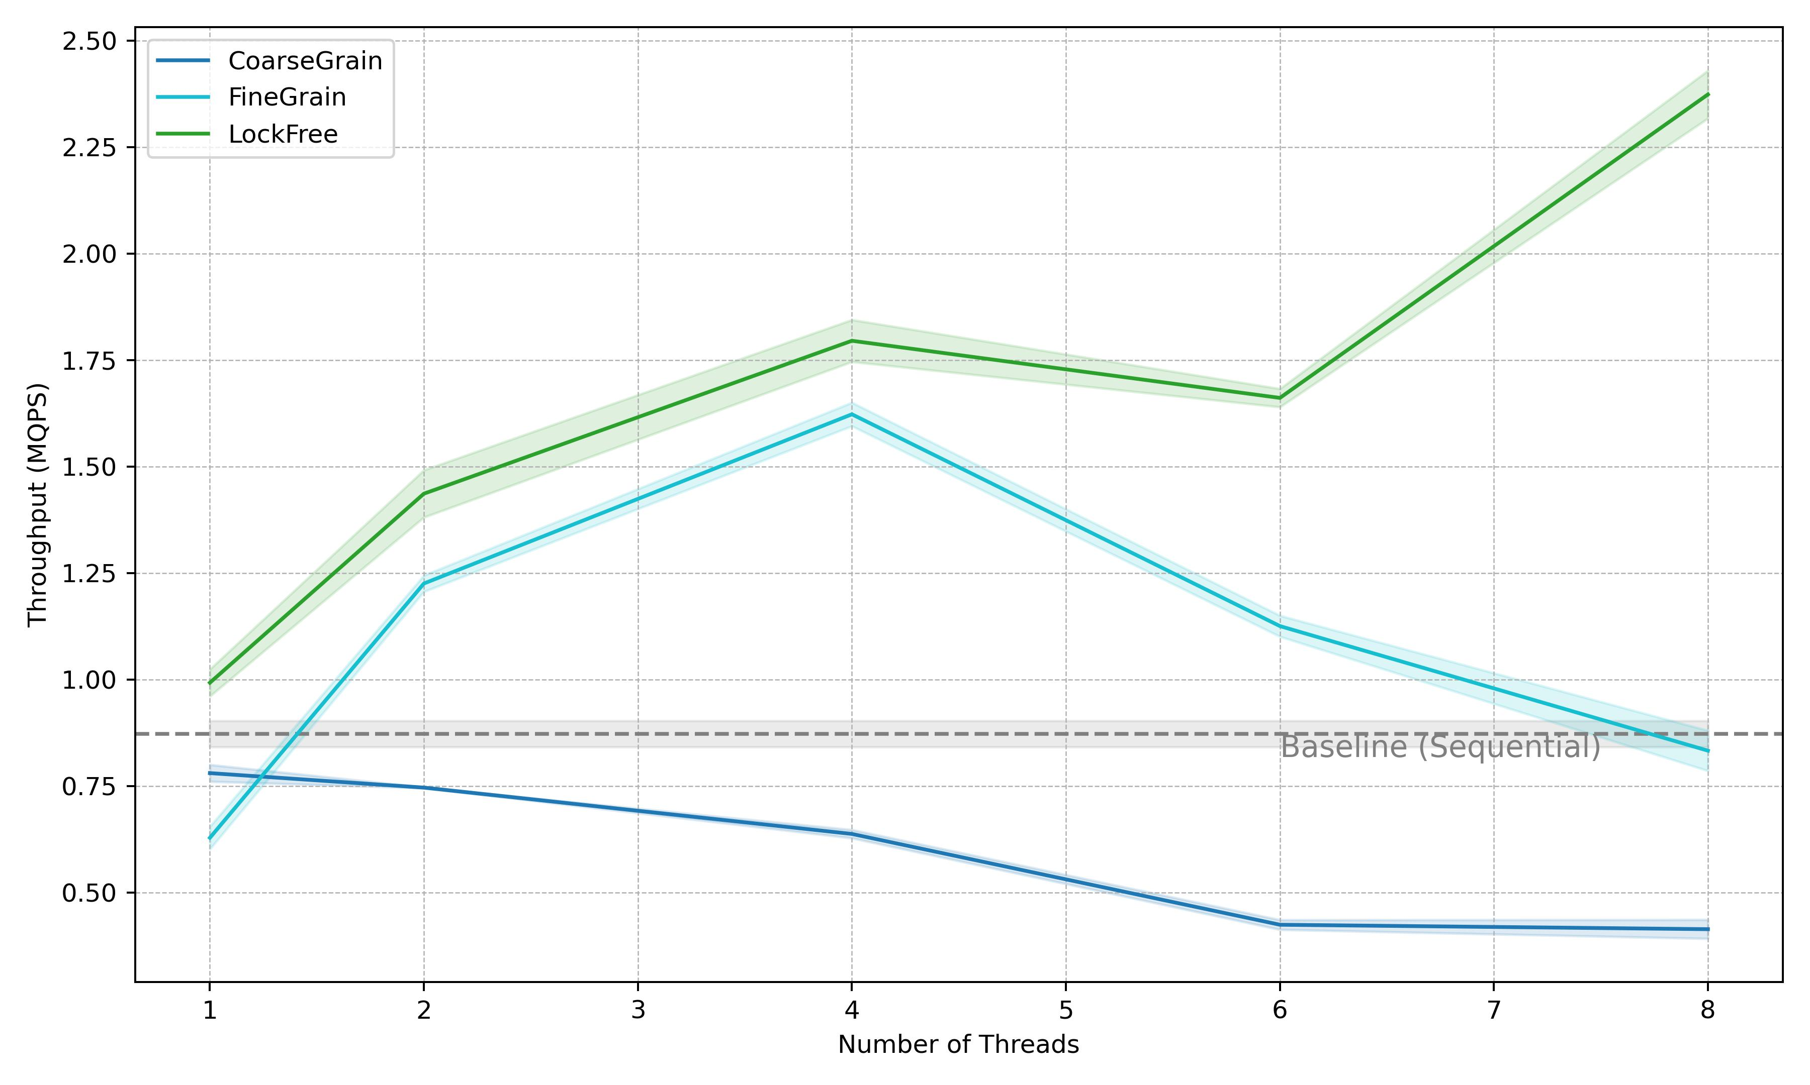
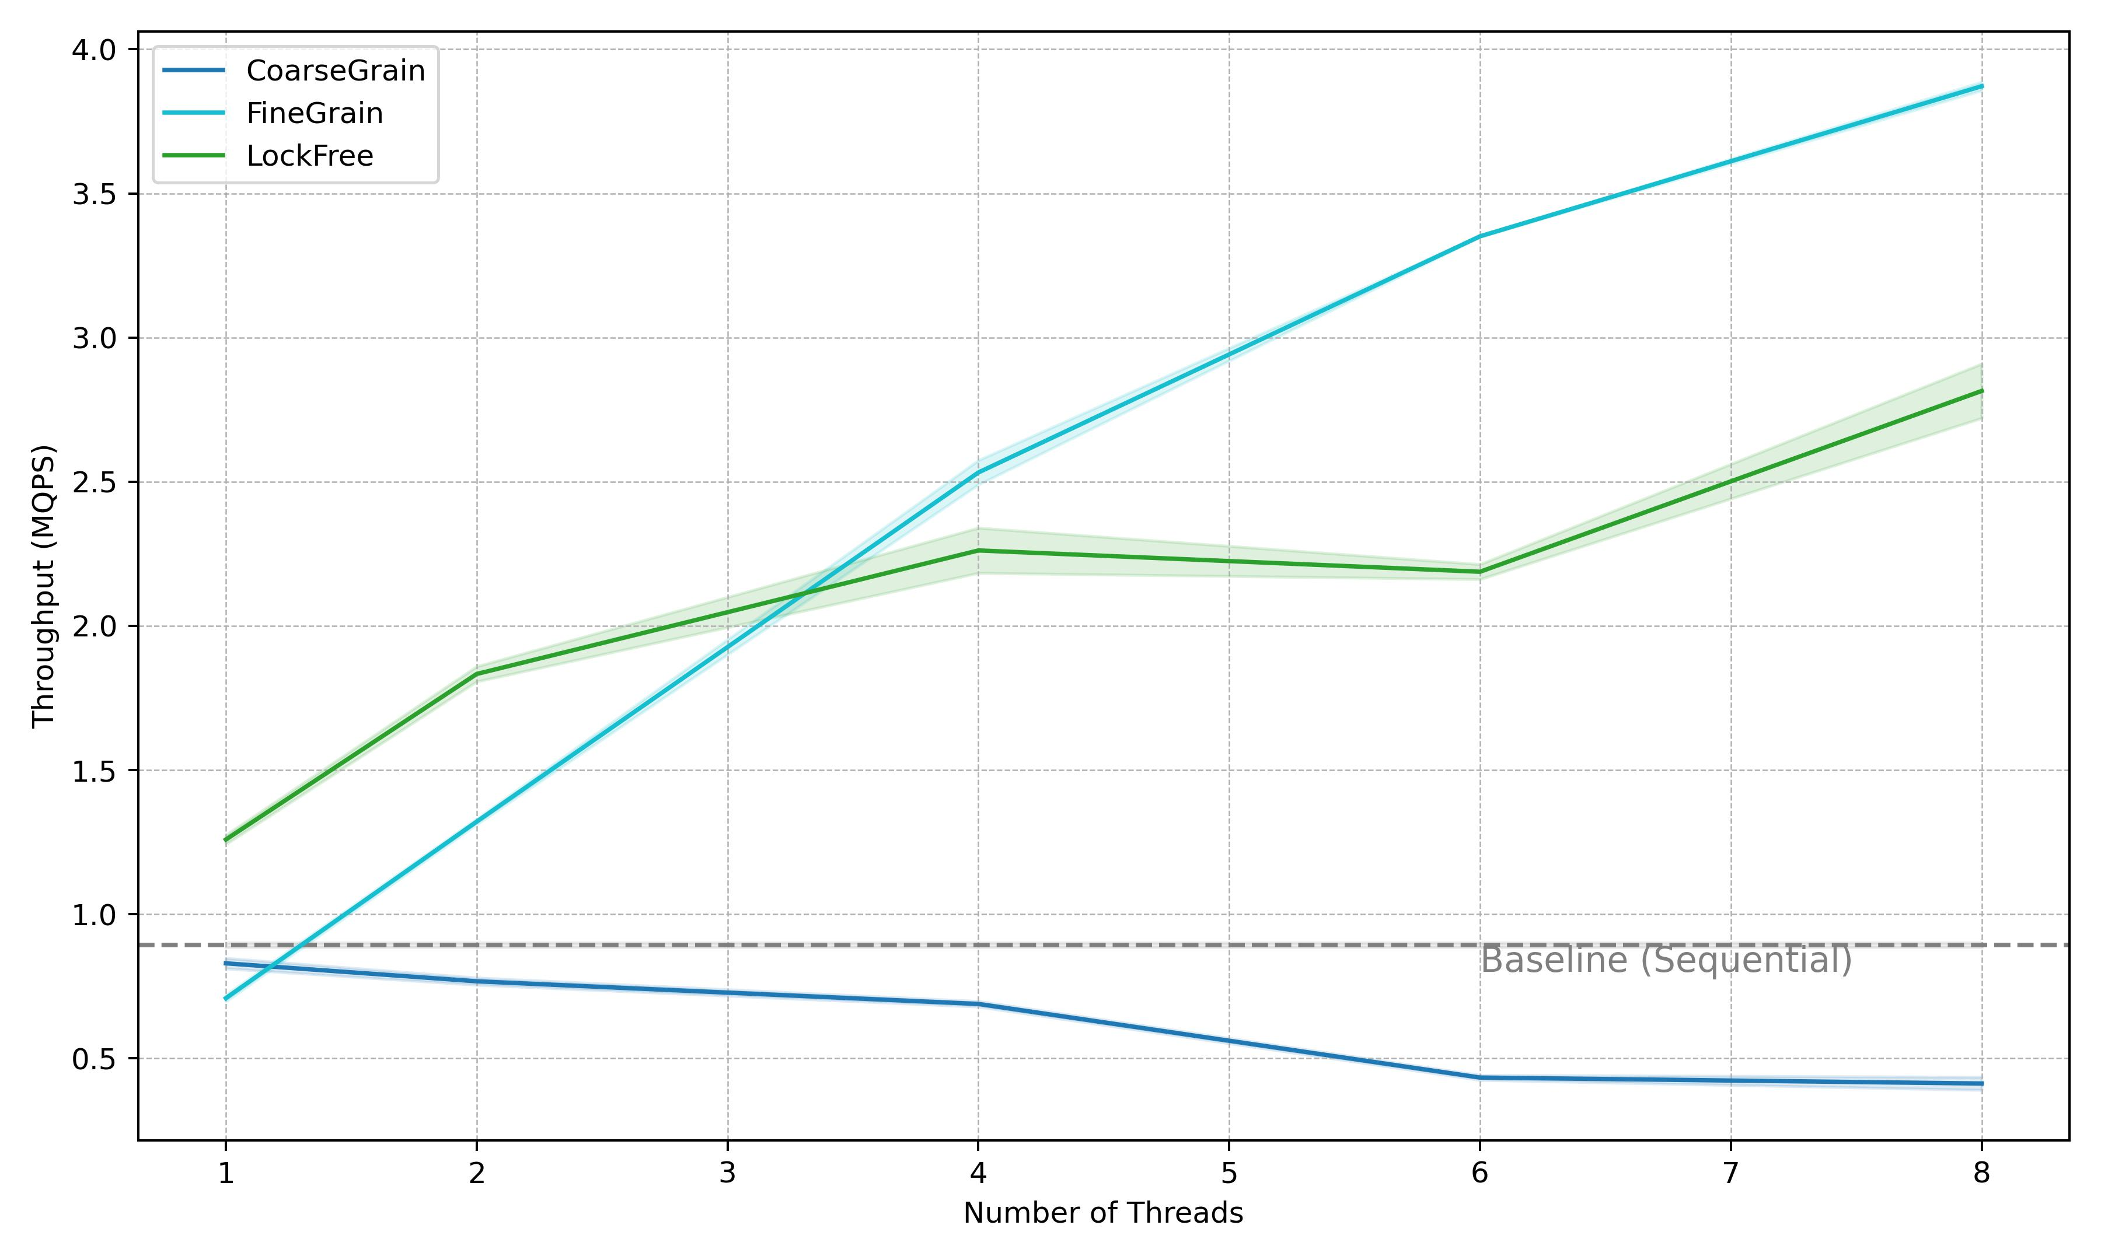
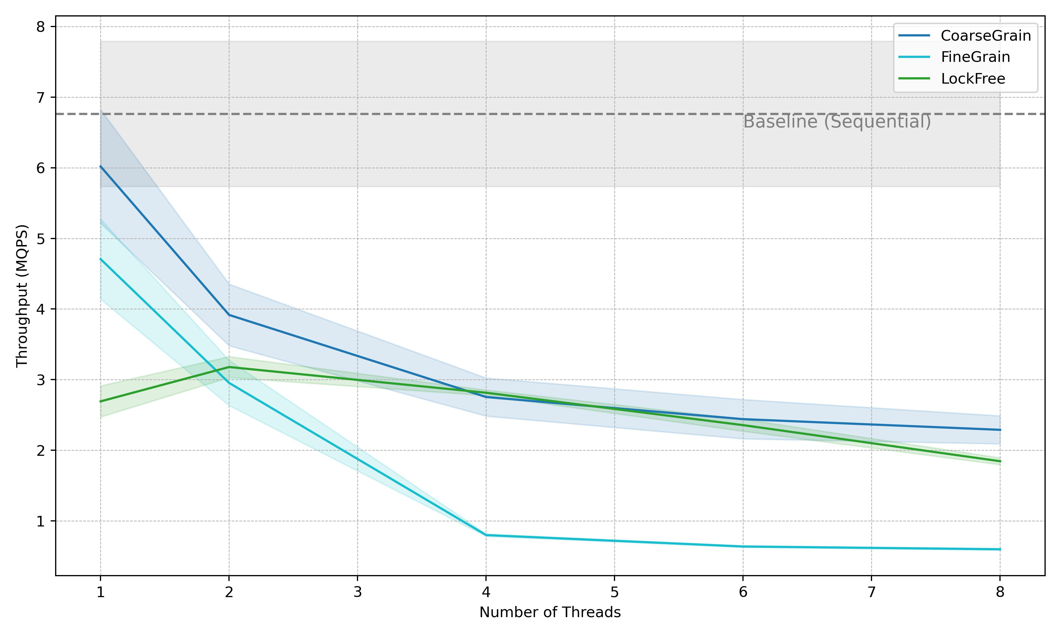
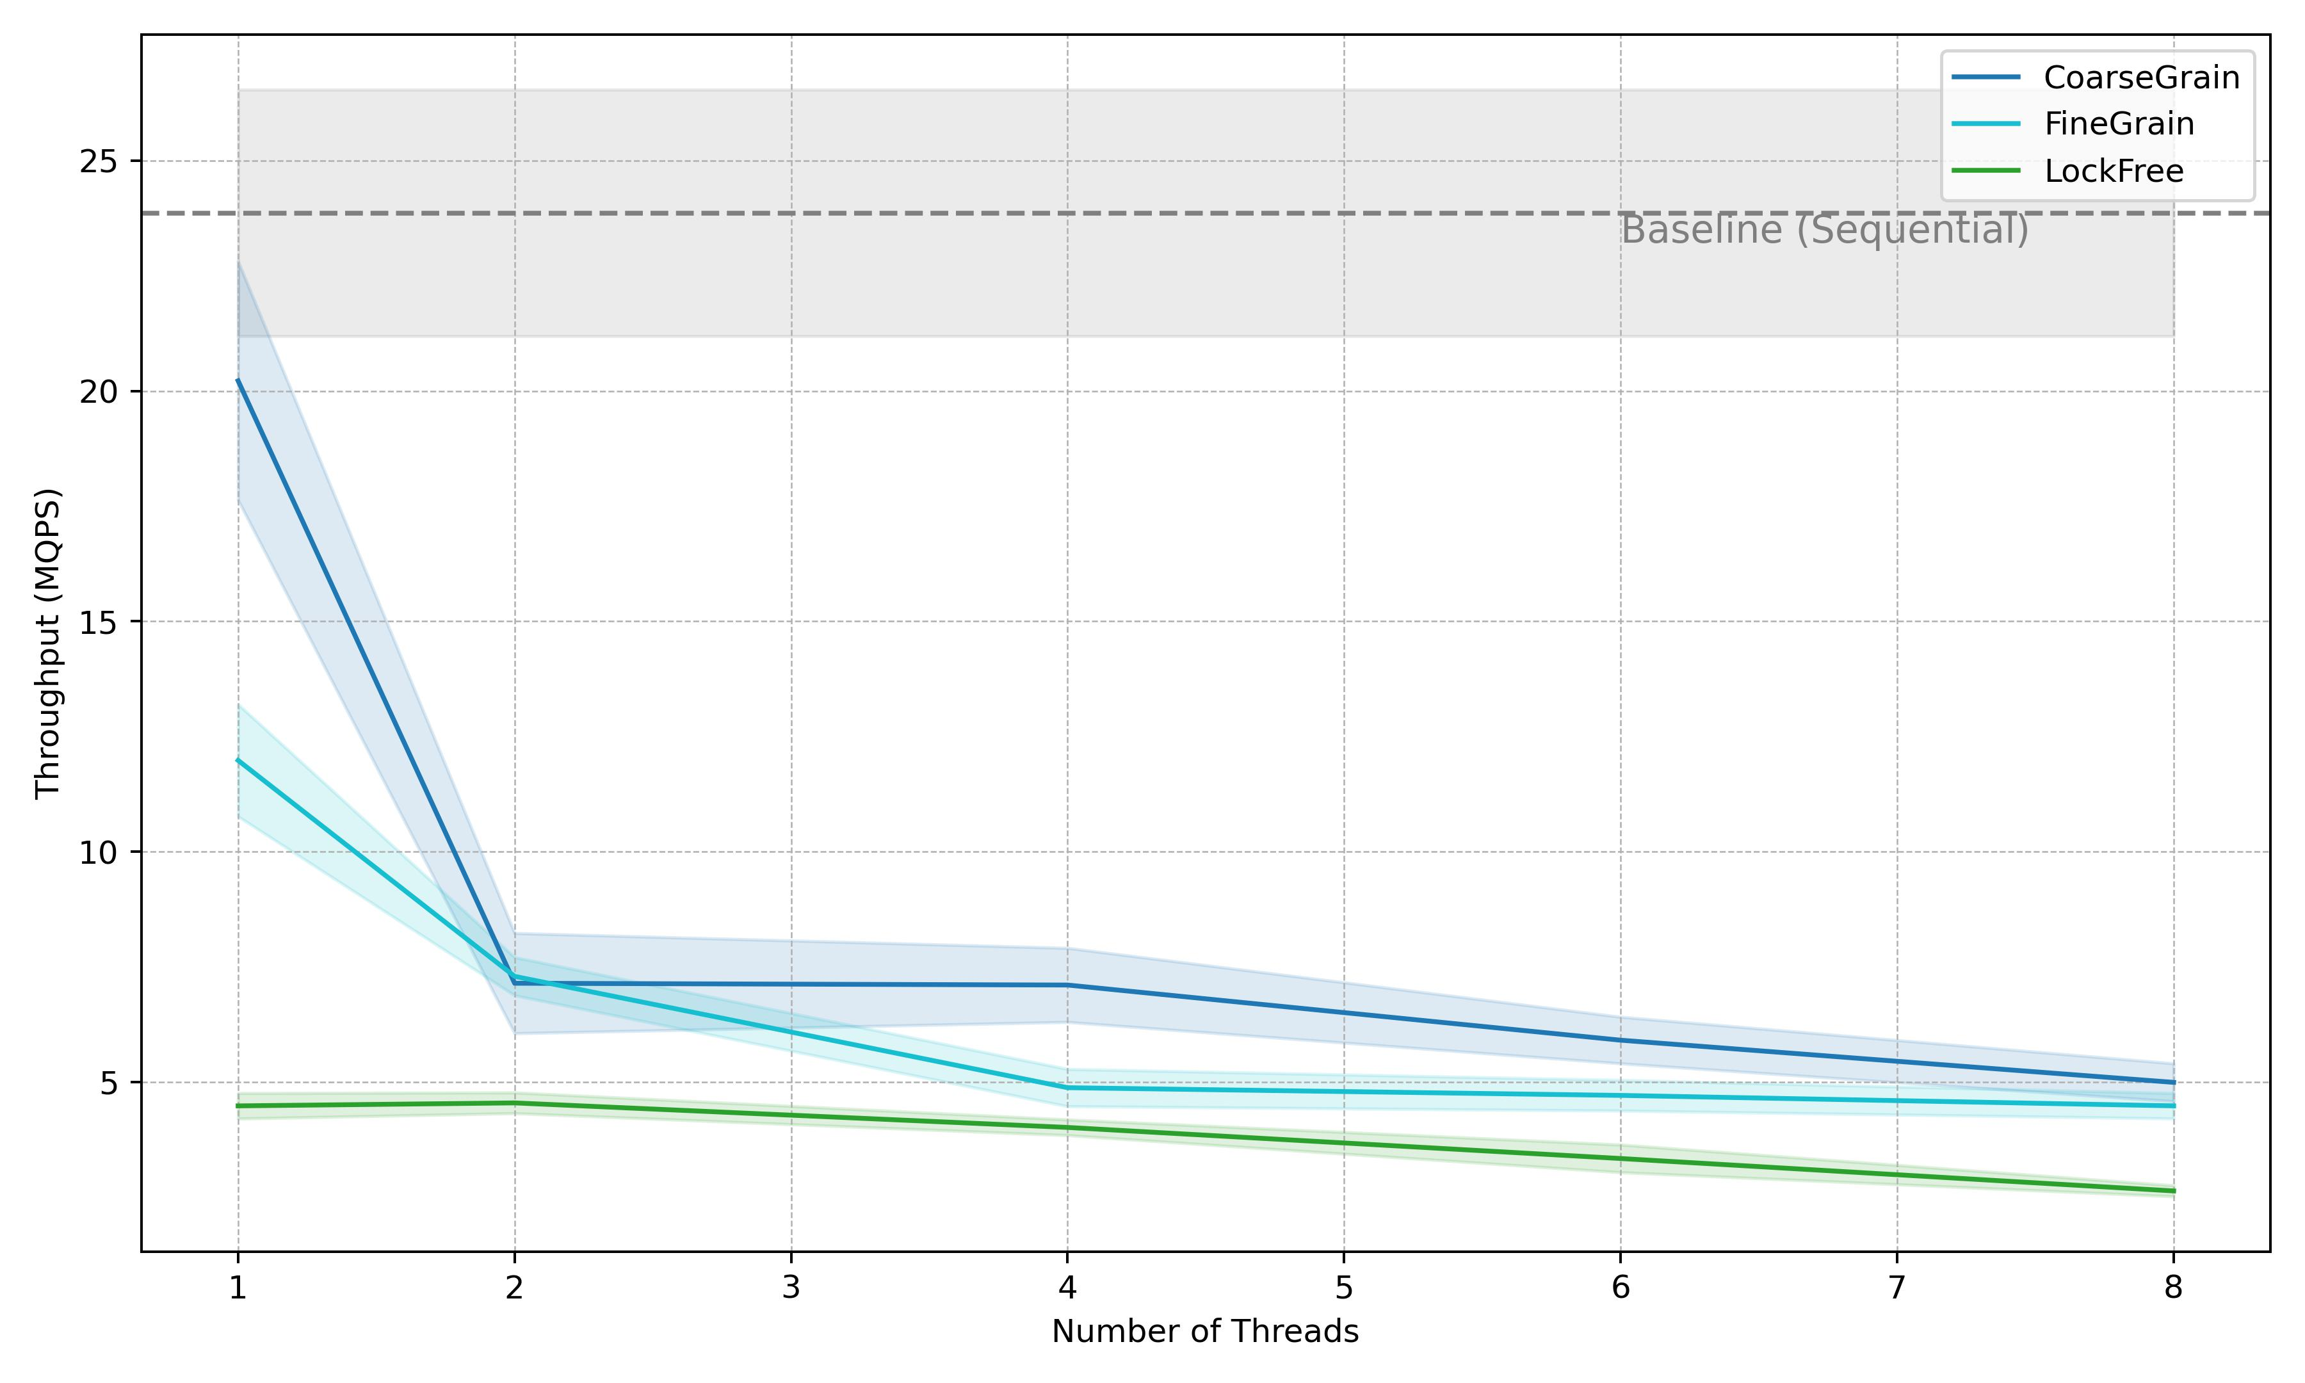


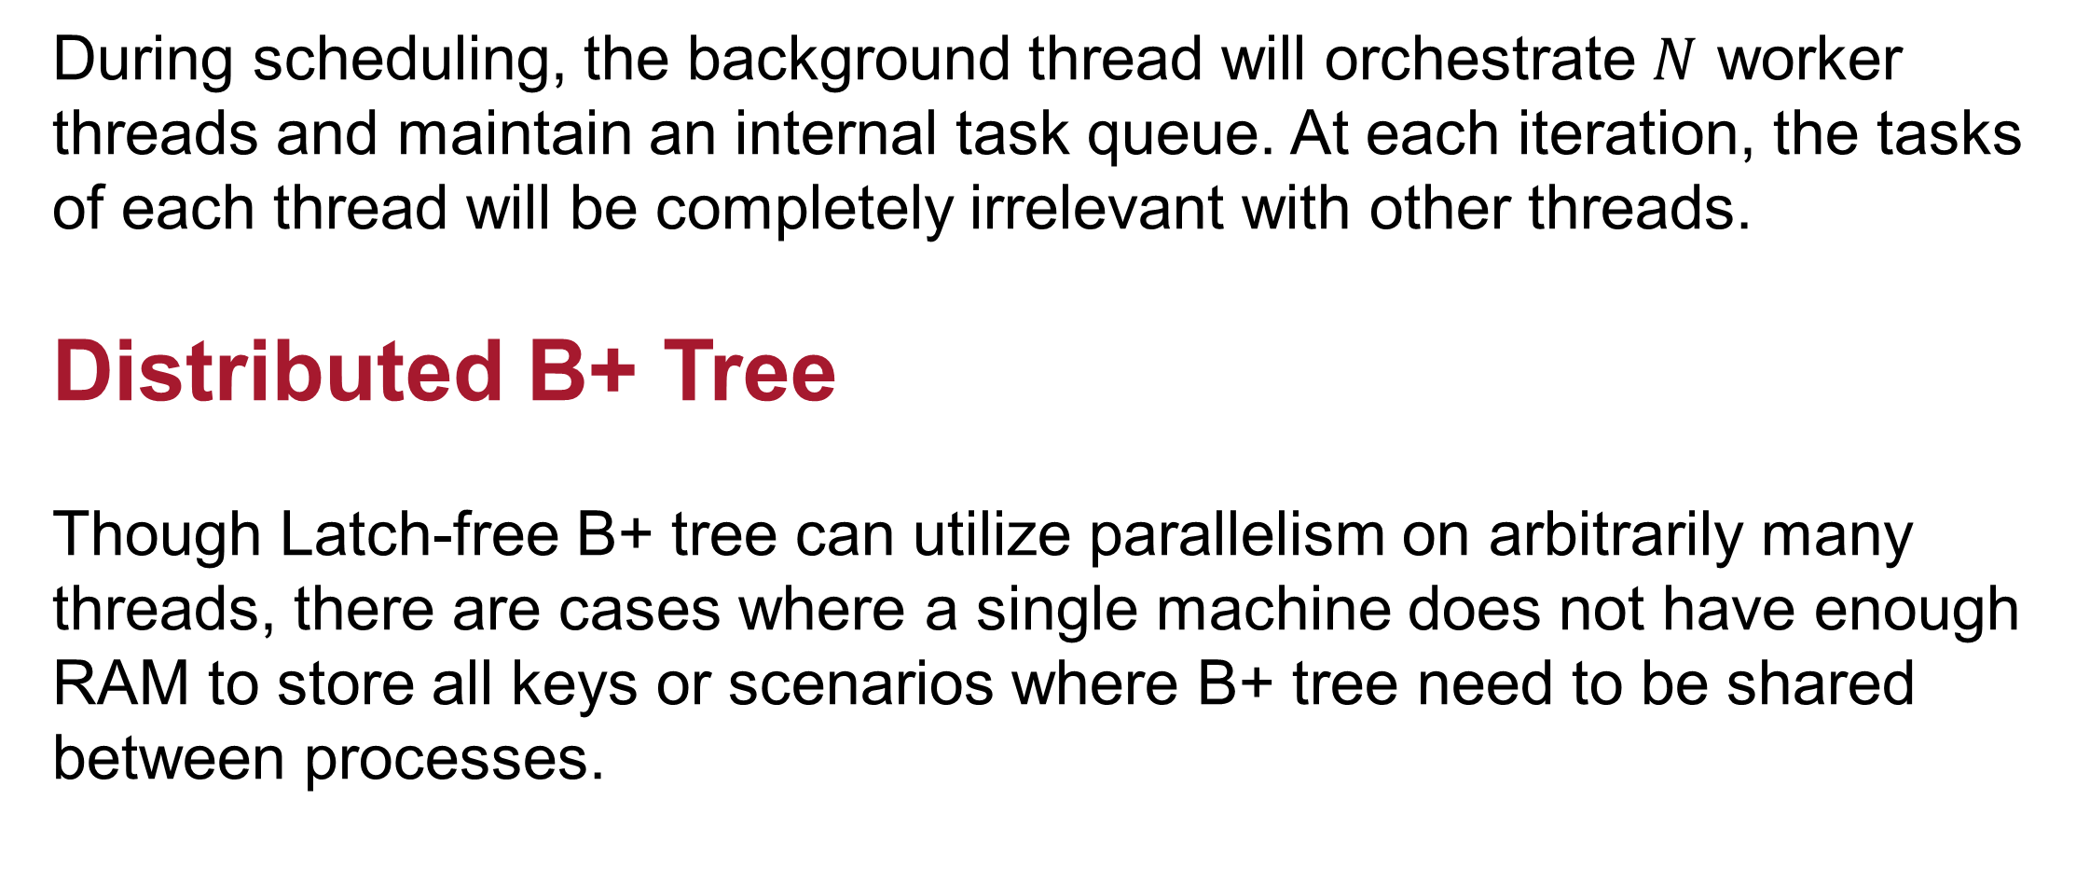



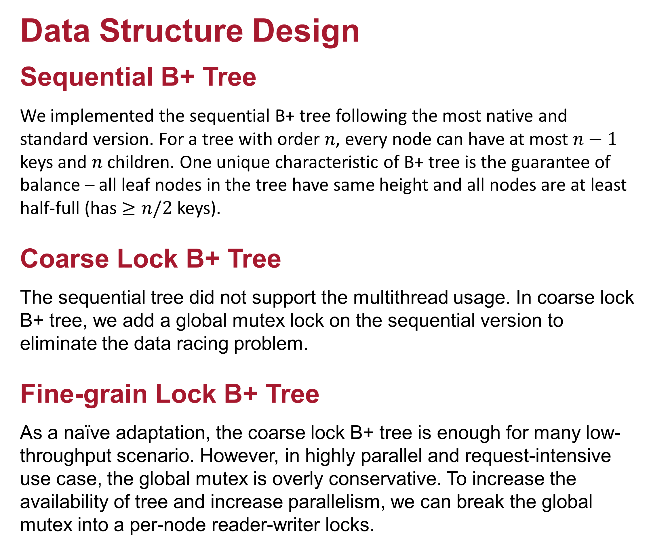


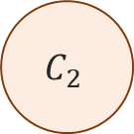



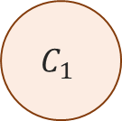






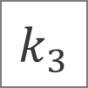

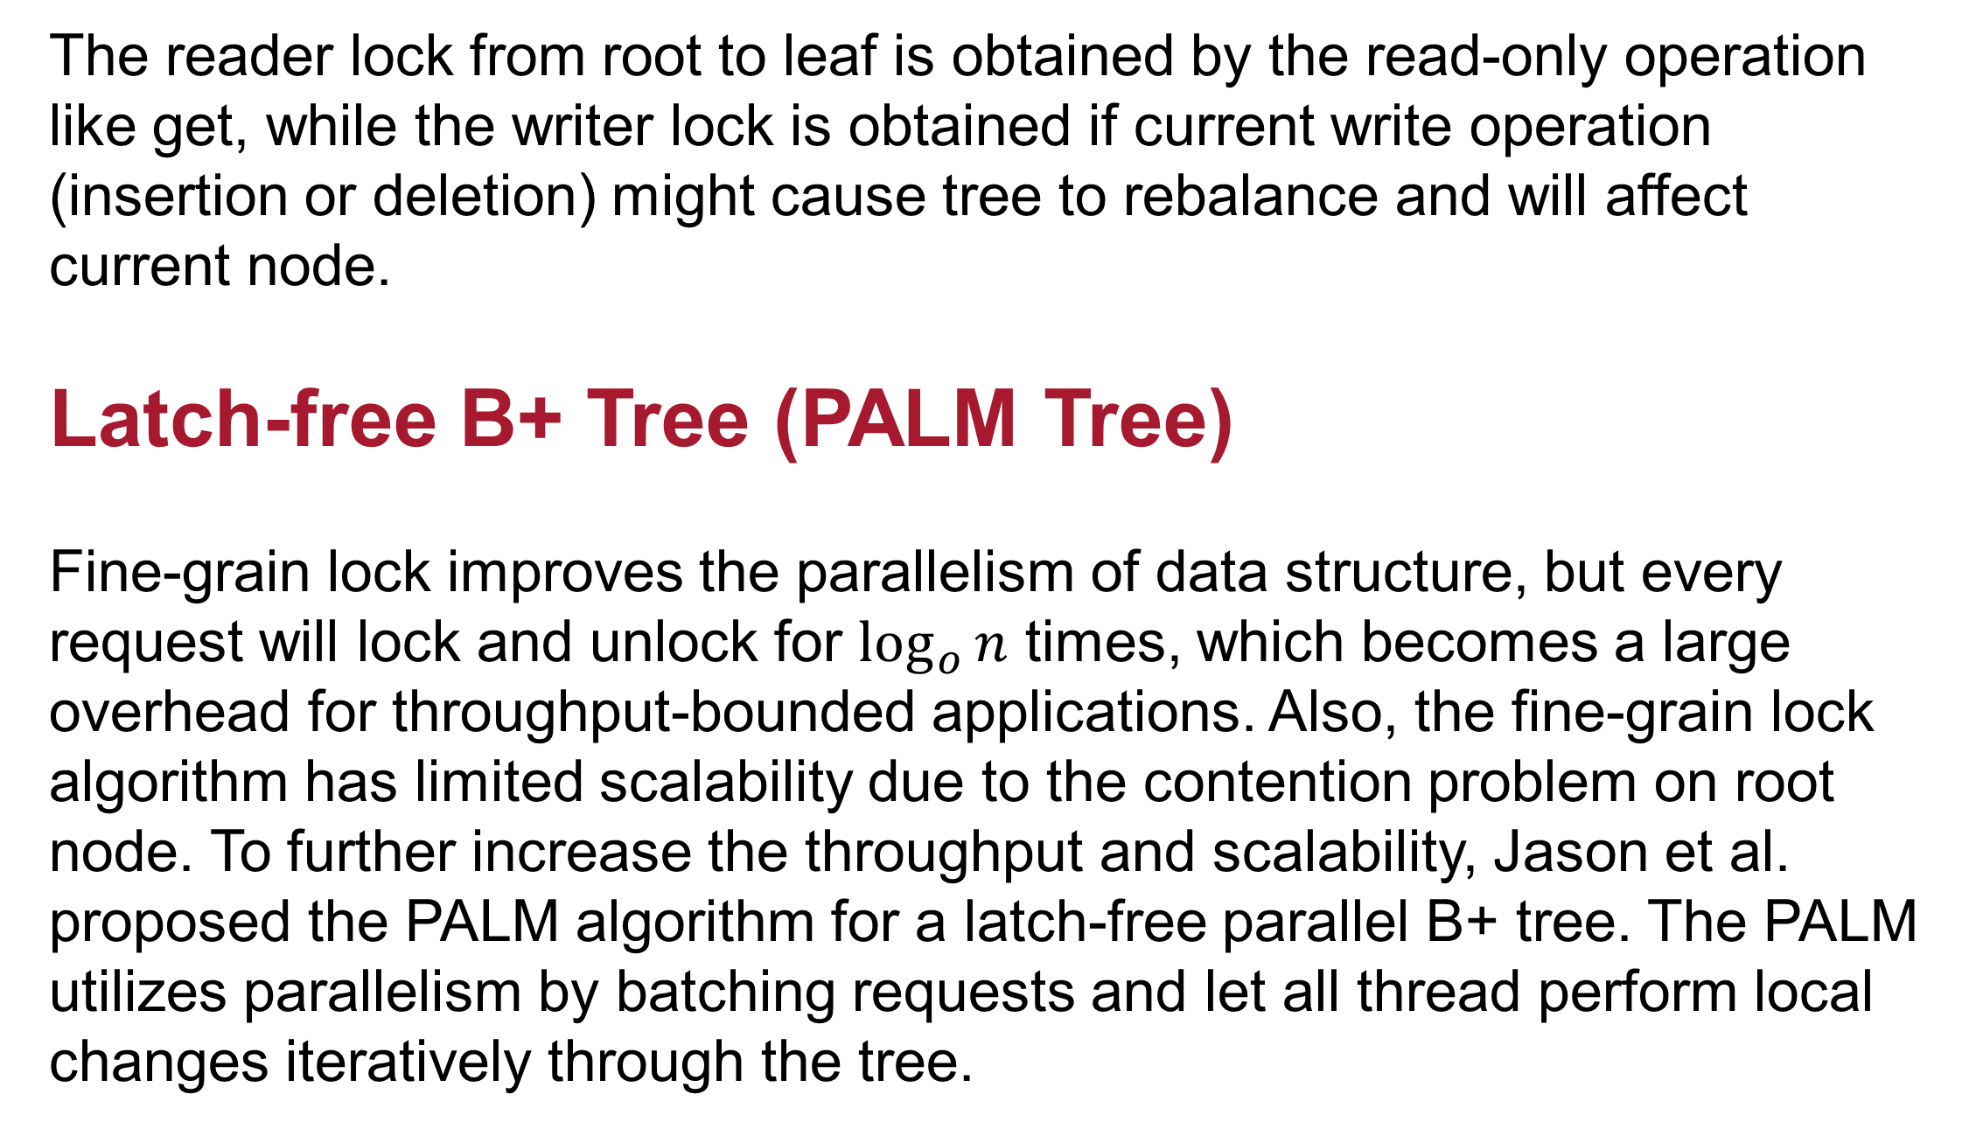


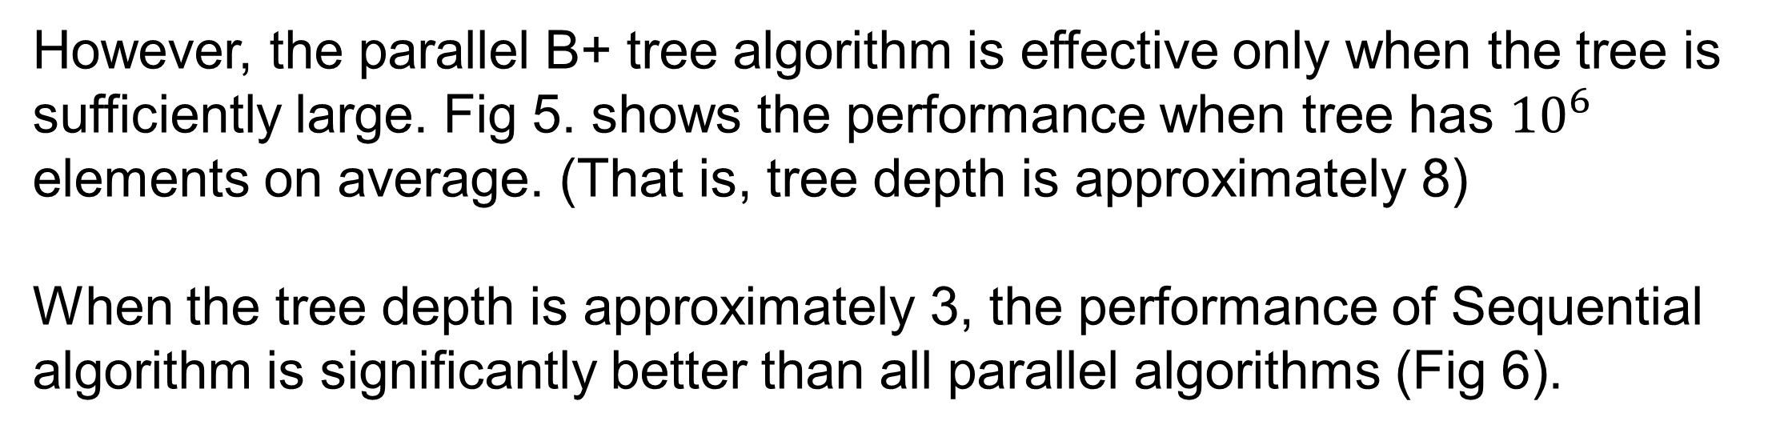


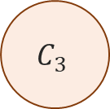



B+ Forest – A Comprehensive Analysis of Parallel B+ Tree Algorithms Yutian Chen, School of Computer Science, yutianch@andrew.cmu.edu Yumeng Liu, School of Computer Science, yumengli@andrew.cmu.edu
Abstract
Our 15-418 final project – B+ Forest – focuses on the implementation and analysis of different B+ tree structures, an essential data structure in database management systems. We implemented and investigated the performance of 5 versions of B+ Trees: (1) sequential B+ Tree, (2) coarse-grained B+ Tree, (3) fine-grained B+ Tree, (4) latch-free B+ Tree, and (5) distributed B+ Tree under different settings.
In this project, we embodied multiple levels of parallelisms in the program. We have utilized the SIMD instructions, multithread, multi-process and even multi-machine distributed system to improve the throughput and scalability of B+ trees.
Get $k_{3}$
Get $k_{2}$
Ins $k_{6}$
To fill up this corner of the throughput-scalability plot, we implemented a distributed B+ tree based on OpenMPI. In the distributed B+ tree, every node maintains a local and partial B+ tree. Inter-process communication will occur only during get and delete operation.
Thread 1
Thread 2
Thread 3
Thread 1 holds the reader lock at leaf and can only read.
Since get $k_{2}$ is a read-only operation, thread 2 share reader lock with thread 1.
Since $k_{6}>k_{1}$ and the node will not overflow, thread 3 can run in parallel.
Shared Memory Space
Background Thread 2
Client #2
$$k_{1}$$
$$−$$
$$−$$
2
Client Thread
Background Thread
Request 2
Get $k_{2}$
Access local tree, perform action and send back the results
R
Send Request
Receive Result
Receive Request
Send Result
Pending
Result 2
Pending
Result 3
For Get, Delete operations, client broad cast operation and key to all nodes in cluster.
$$k_{2}$$
$$k_{3}$$
$$−$$
2
$$k_{3}$$
$$k_{4}$$
W
Get $k_{2}$
Computation Node #2
R
$$k_{1}$$
$$k_{4}$$
$$−$$
Local (Partial)
Fine-grain B+ Tree
Background Thread 3
Client #3
Fig 2. Fine-grain lock B+ Tree, using reader-writer lock on each node.
Result 3
NONE
Scalability
The reader lock from root to leaf is obtained by the read-only operation like get, while the writer lock is obtained if current write operation (insertion or deletion) might cause tree to rebalance and will affect current node.
Latch-free B+ Tree (PALM Tree)
Fine-grain lock improves the parallelism of data structure, but every request will lock and unlock for $\log_{o}{n}$ times, which becomes a large overhead for throughput-bounded applications. Also, the fine-grain lock algorithm has limited scalability due to the contention problem on root node. To further increase the throughput and scalability, Jason et al. proposed the PALM algorithm for a latch-free parallel B+ tree. The PALM utilizes parallelism by batching requests and let all thread perform local changes iteratively through the tree.
$$k_{2}$$
$$k_{3}$$
$$−$$
$$k_{3}$$
$$−$$
$$k_{4}$$
$$−$$
Computation Node #1
Computation Node #3
Multi-Machine
Distributed Tree
Fig 4. Distributed B+ Tree Algorithm
Results
We evaluated the algorithms in different working condition and with different number of threads. In intense read scenario, fine-grain lock algorithm performs the best, while in intense write scenario, the latch-free algorithm performs the best.
Multi-Process
Latch-Free Tree
Multi-Thread
Coarse-grain
Fine-grain
1
Sequential
5
10
Throughput
Fig 1. 5 Different B+ Trees implemented in this project and their relative speedup/scalability. Each tree satisfy a specific scenario.
Data Structure Design
Sequential B+ Tree
We implemented the sequential B+ tree following the most native and standard version. For a tree with order $n$, every node can have at most $n−1$ keys and $n$ children. One unique characteristic of B+ tree is the guarantee of balance – all leaf nodes in the tree have same height and all nodes are at least half-full (has $≥n/2$ keys).
Coarse Lock B+ Tree
The sequential tree did not support the multithread usage. In coarse lock B+ tree, we add a global mutex lock on the sequential version to eliminate the data racing problem.
Fine-grain Lock B+ Tree
As a naïve adaptation, the coarse lock B+ tree is enough for many low-throughput scenario. However, in highly parallel and request-intensive use case, the global mutex is overly conservative. To increase the availability of tree and increase parallelism, we can break the global mutex into a per-node reader-writer locks.
Stage 1
Stage 2
Worker Threads
Search
Distribute
Leaf Execute
Background Thread
$$C_{1}$$
Lock-free
Request
Queue
Client Thread(s)
Fig 5. Benchmarking result – Intense Write (Left) and Intense Read (Right) on Heavy B+ Tree (with depth $≈8$)
$$C_{2}$$
Collect
Root Execute
Re-Distribute
Internal Execute
However, the parallel B+ tree algorithm is effective only when the tree is sufficiently large. Fig 5. shows the performance when tree has ${10}^{6}$ elements on average. (That is, tree depth is approximately 8)
When the tree depth is approximately 3, the performance of Sequential algorithm is significantly better than all parallel algorithms (Fig 6).
$$C_{3}$$
Stage 4
Stage 3
Fig 3. 4 Stages of the PALM algorithm
During scheduling, the background thread will orchestrate $N$ worker threads and maintain an internal task queue. At each iteration, the tasks of each thread will be completely irrelevant with other threads.
Distributed B+ Tree
Though Latch-free B+ tree can utilize parallelism on arbitrarily many threads, there are cases where a single machine does not have enough RAM to store all keys or scenarios where B+ tree need to be shared between processes.
Fig 6. Benchmarking result – Intense Write (Left) and Intense Read (Right) on Lightweight B+ Tree (with depth $≈3$)

